Slide 1
AF: what is the technology and we do properly?
Jamshid Sodikov
Ezgu Niyat Multispecialty Medical Center, Uzbekistan
11th national congress of the Azerbaijan Cardiology Society
9-11 december 2022
Fairmont Hotel, Flame Towers, Baku

Slide 2
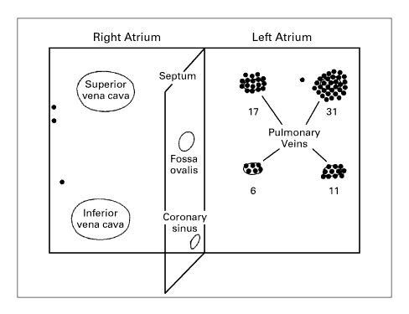
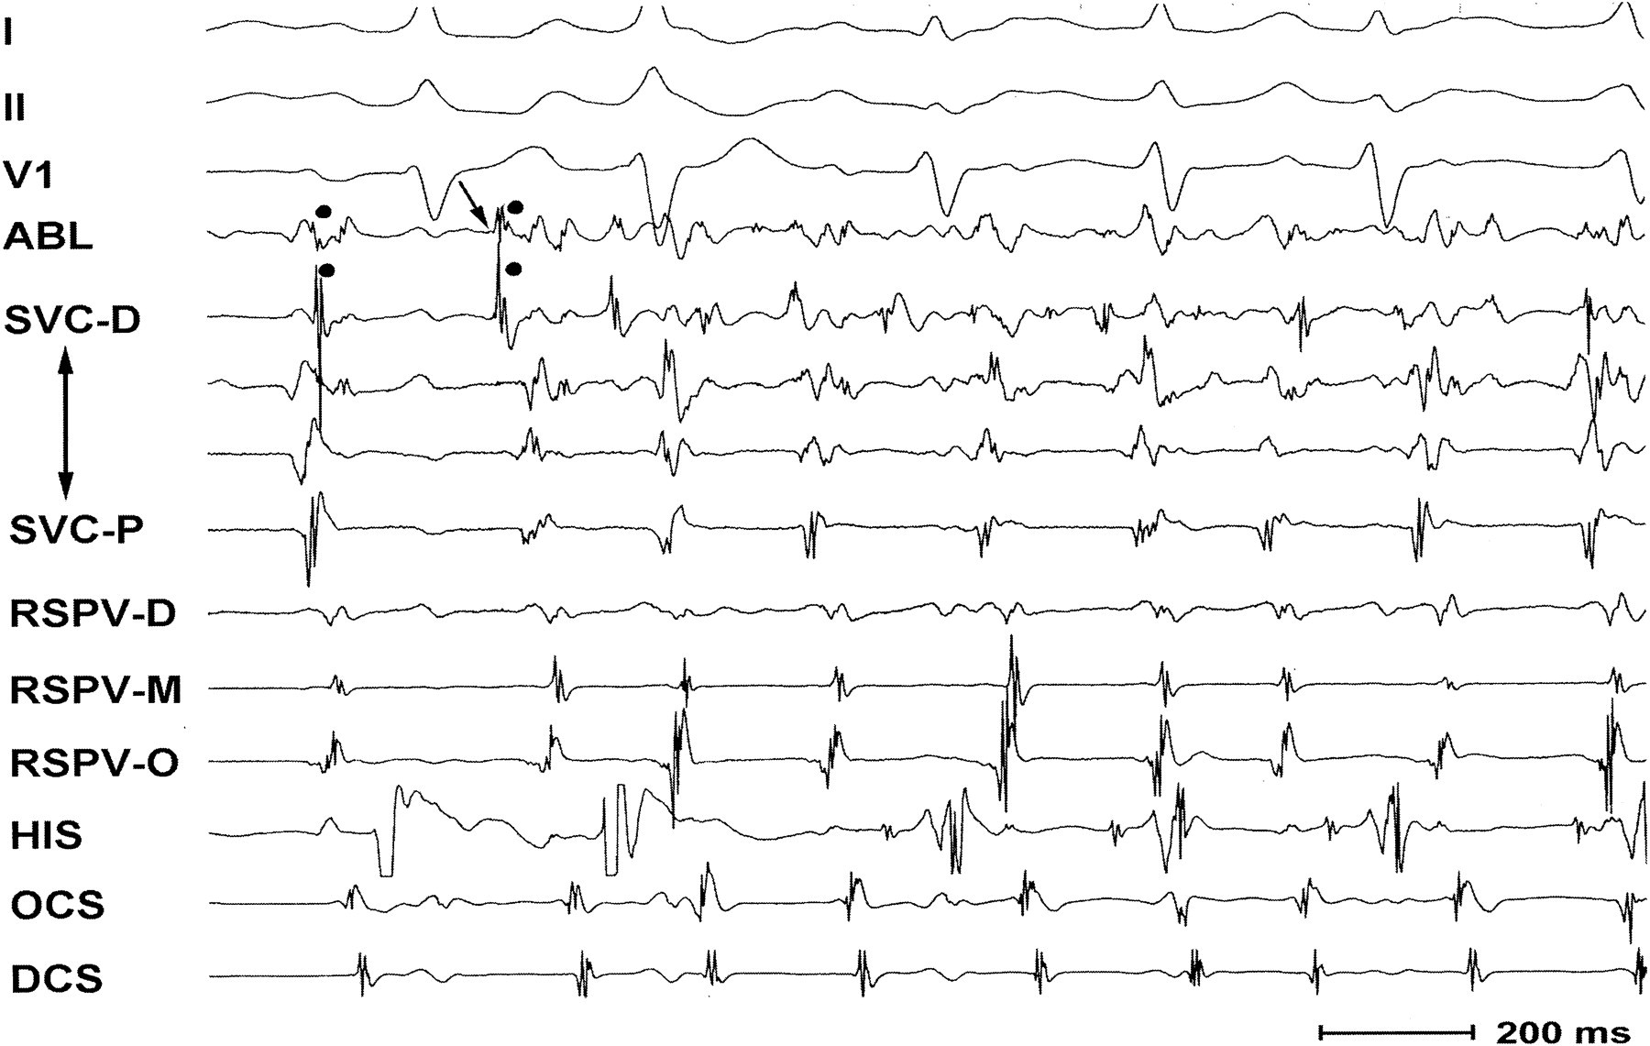
The clinical problem
M. Haïssaguerre et al…N Engl J Med 1998; 339:659-666

Slide 3
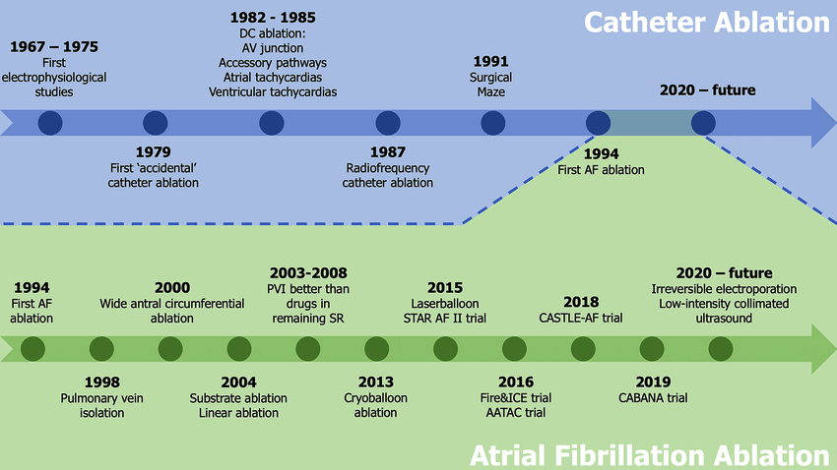
Evolution of ablation

Slide 4
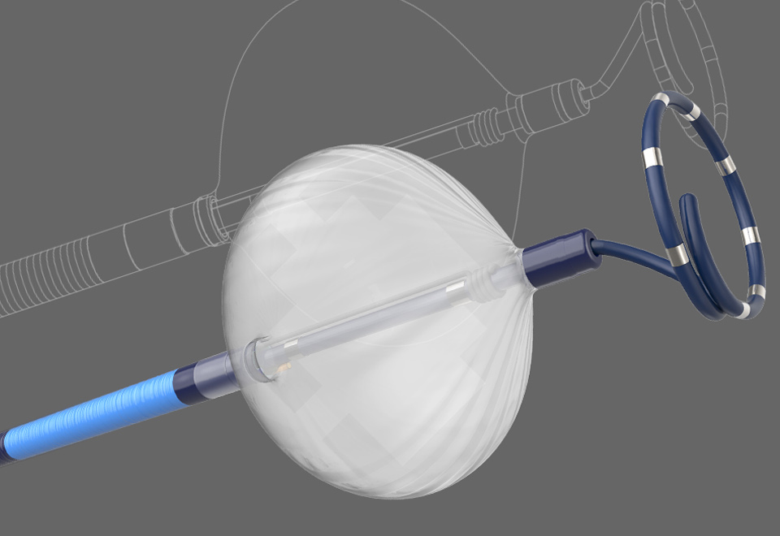
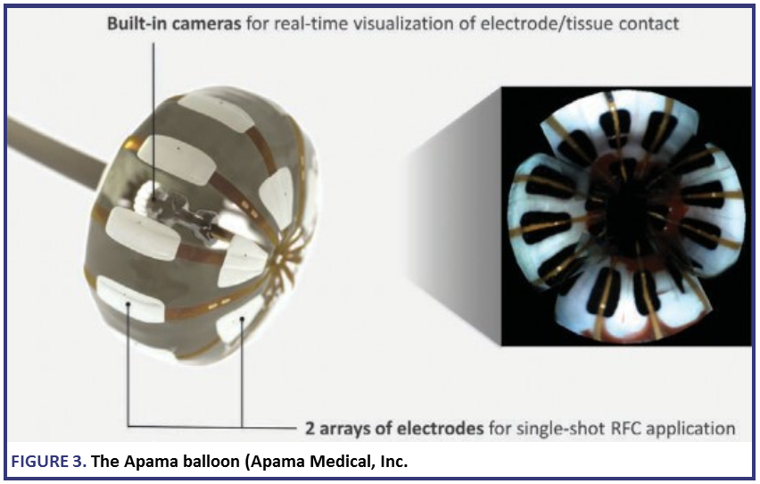
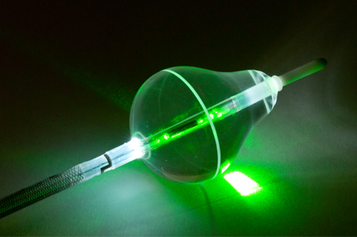
Technologies
Cryoballoon
Laser balloon
HIFU
RF Mersh, nMARq, PVAC
RF balloon
Surgery approaches
External radiation
DC electroporation
Ultralow $t°$cryoablation

Slide 5
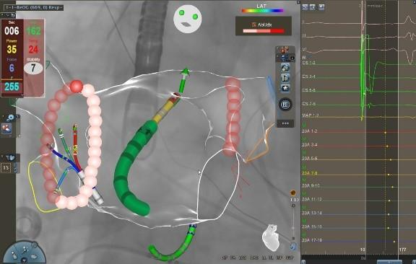
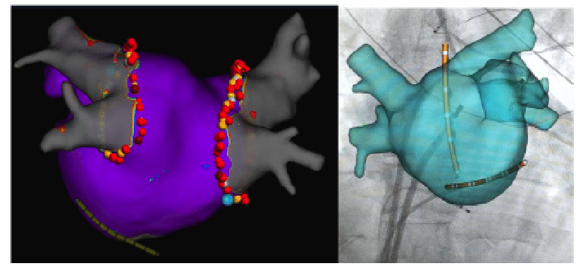
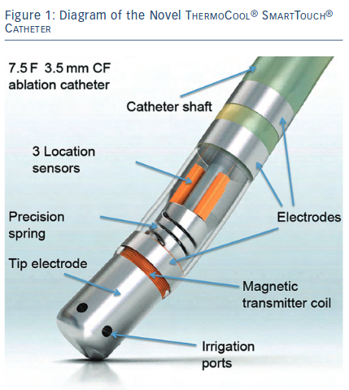
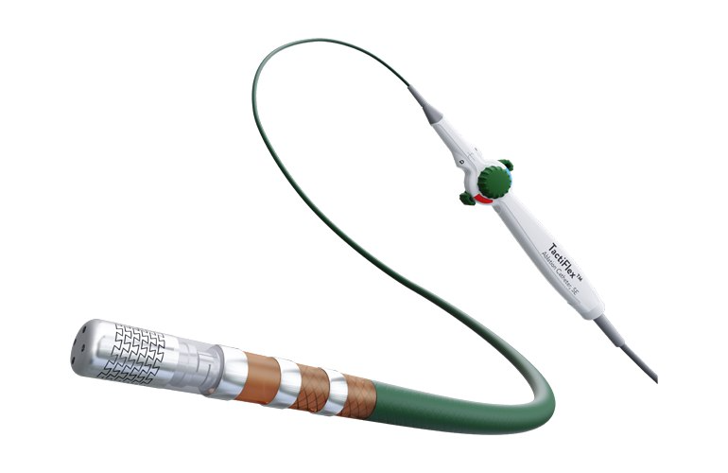
Traditional RF ablation

Slide 6
RF Ablation with multielectrode catheter

Slide 7
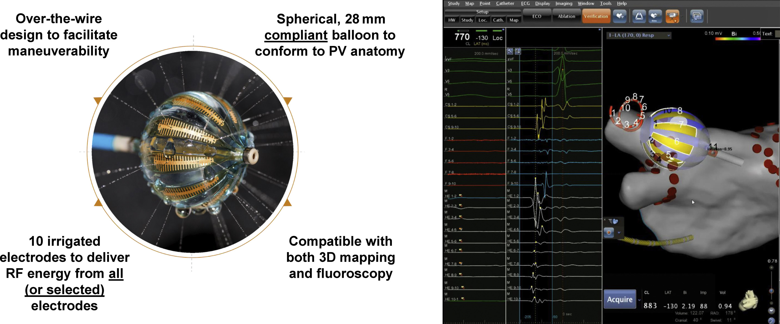
RF Ablation with multielectrode catheter

Slide 8
RF outcomes today – the VISTAX trial
329 procedures across 15 centers
89% single procedure success using standard monitoring
Highly reproducible acute and long term outcomes
Europace, Volume 22, Issue 11, November 2020, Pages 1645–1652, https://doi.org/10.1093/europace/euaa157
The content of this slide may be subject to copyright: please see the slide notes for details.

Slide 9
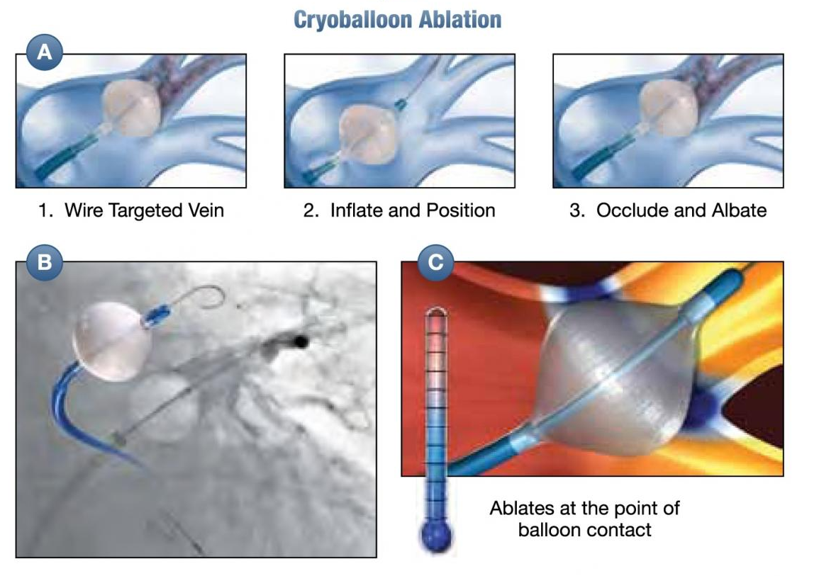
Cryoballoon ablation

Slide 10
Cryoballoon ablation
Advantages:
Potentially shorter procedures (possibly only one 3-min freeze per vein)
Single transseptal puncture possible
No need for an electroanatomical mapping system
Possibly less conscious sedation
Disadvantages:
Less versatile (additional lines)
Larger caliber of transseptal sheath
More radiation when compared with RFA with mapping system
Little flexibility in difficult anatomies
Of limited value in ablation of persistent AF

Slide 12
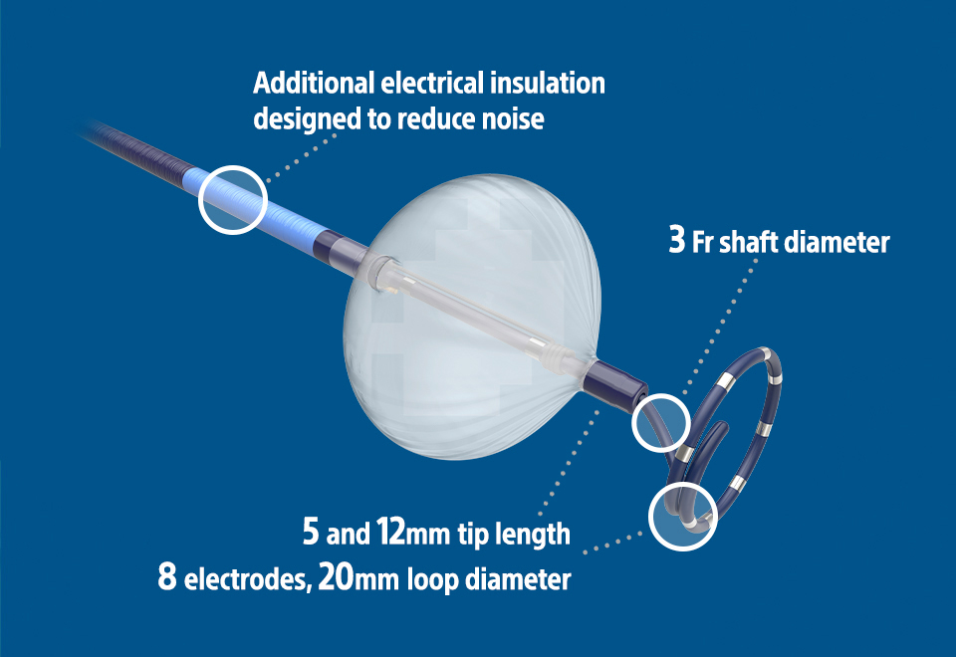
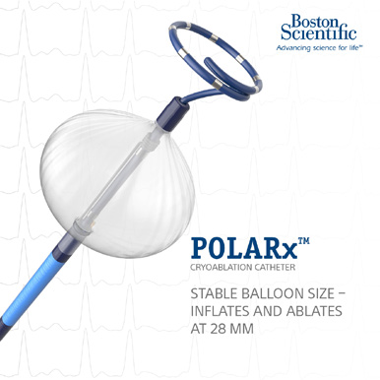
New cryoballoon

Slide 14
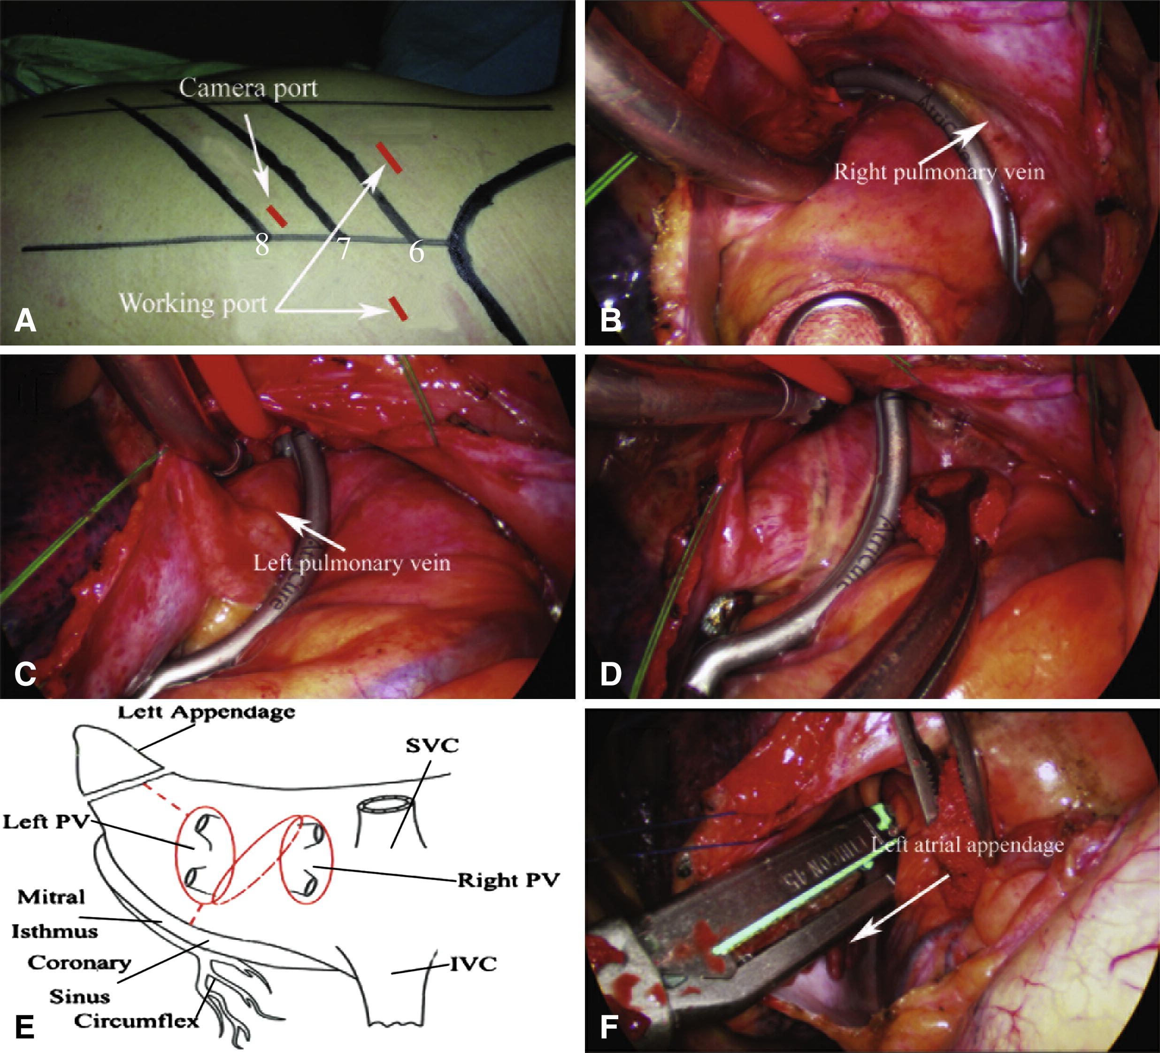
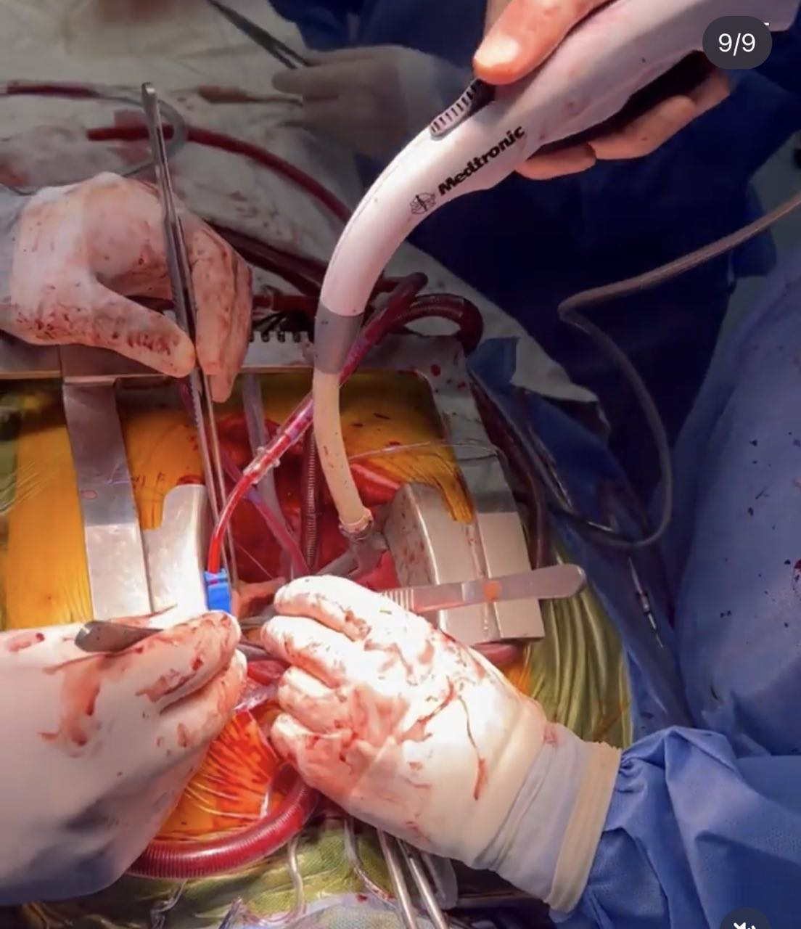
Surgical ablation

Slide 15
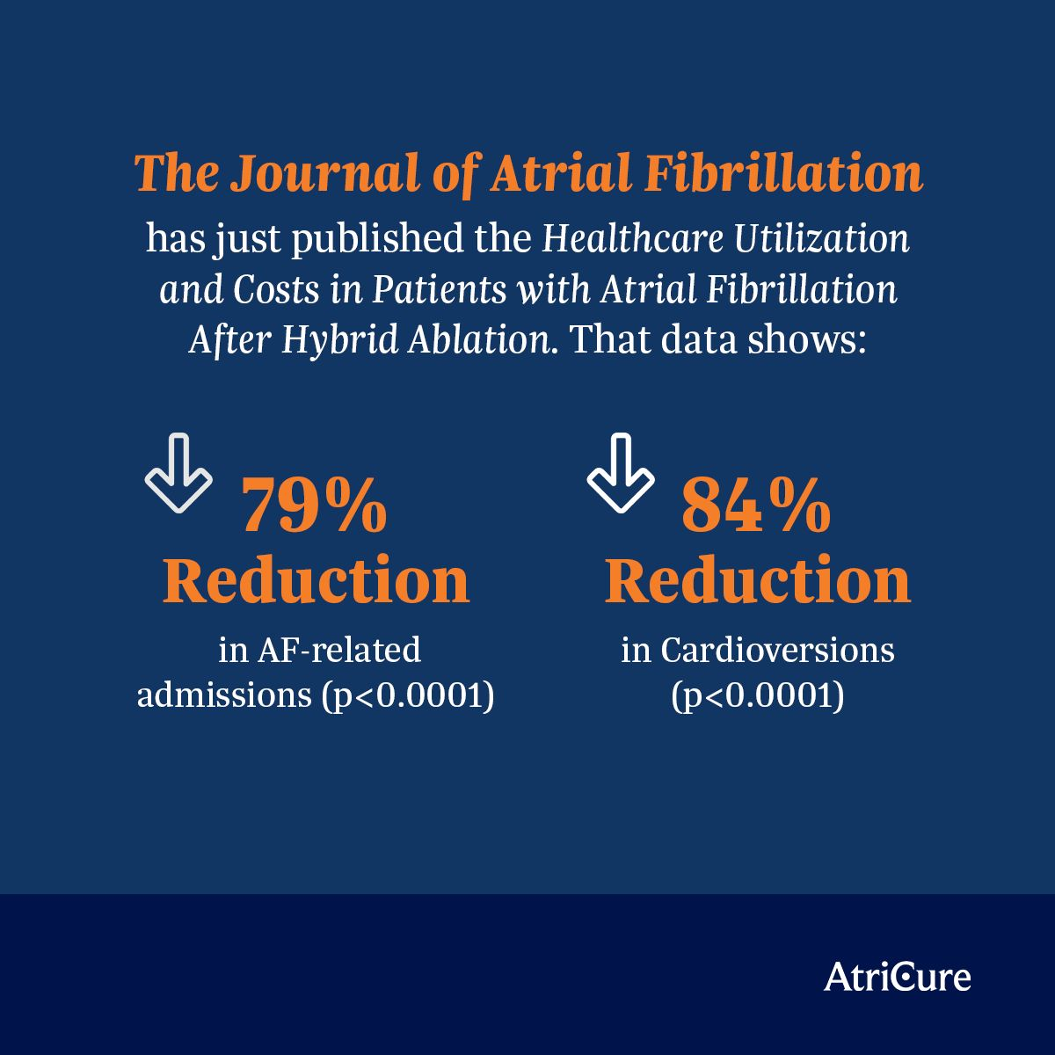
Surgical ablation

Slide 16
Surgical ablation

Slide 17
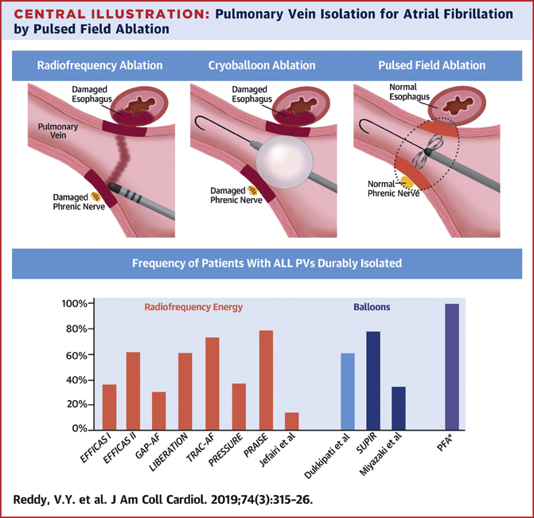
Pulsed Field Ablation
Cell membrane damage through DC current (“irreversible electroporation”).
Non-thermal ablation
Voltage-mediated tissue selectivity observed
2. Early data indicates sparing of esophagus and phrenic nerve

Slide 18
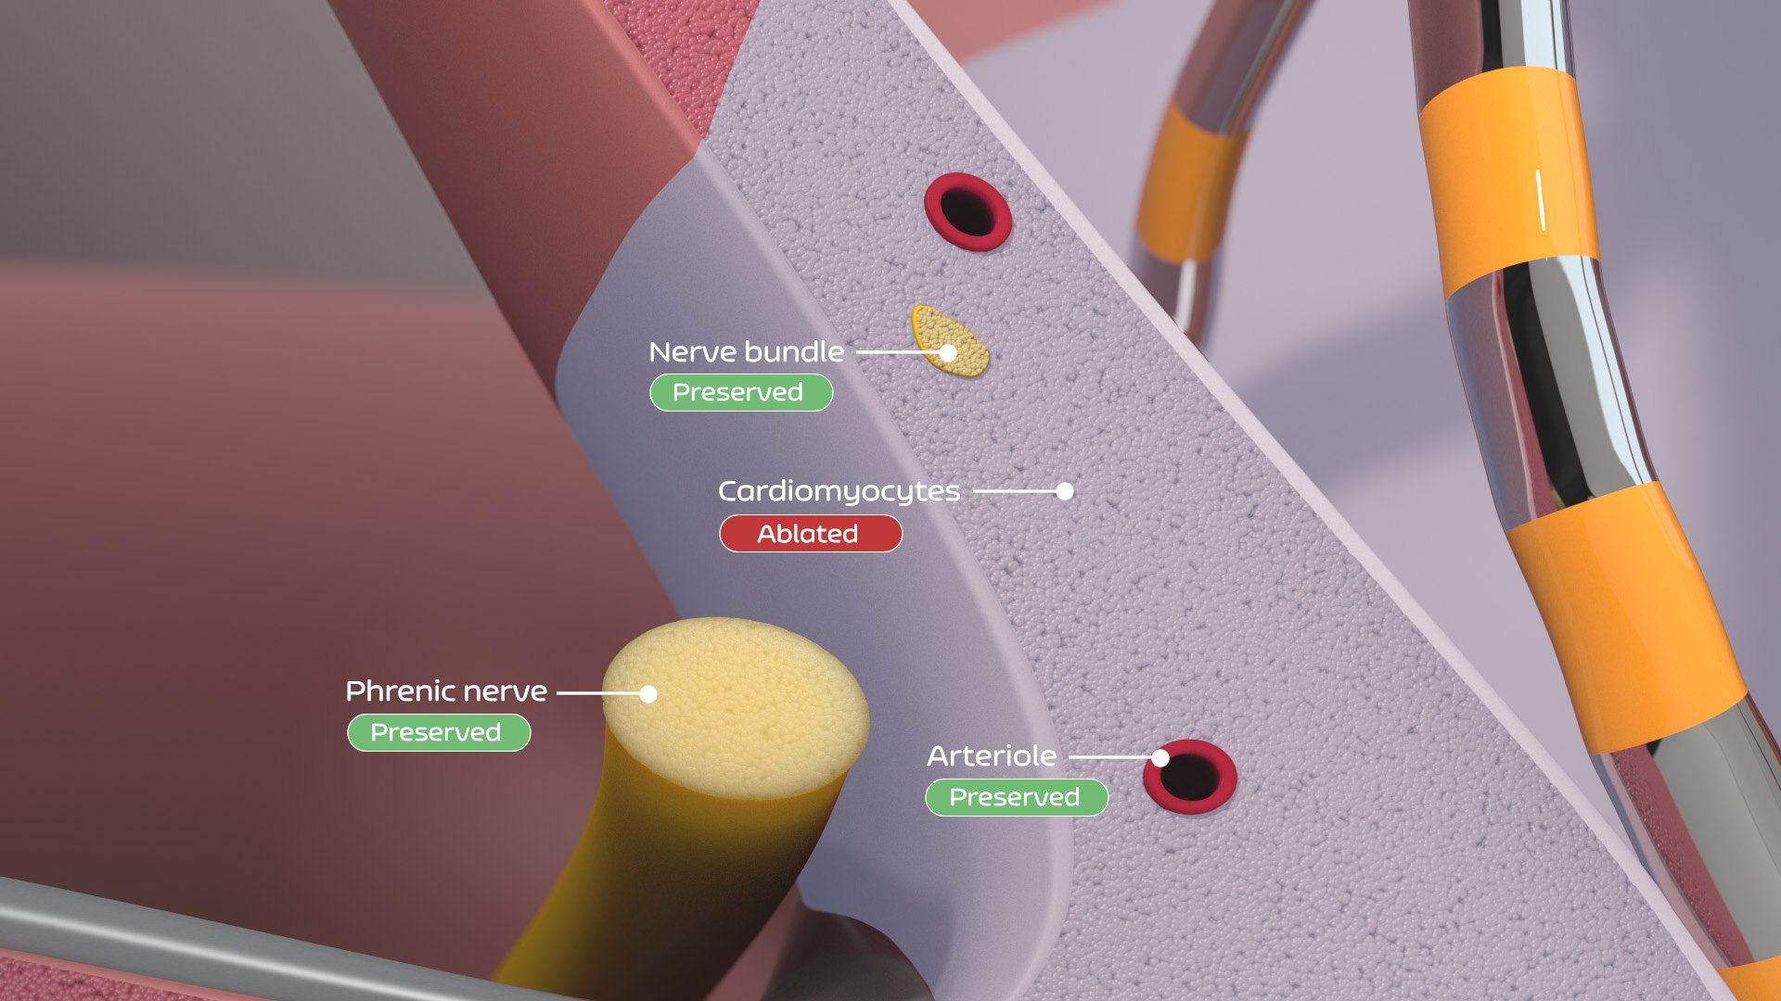
Pulsed Field Ablation

Slide 19
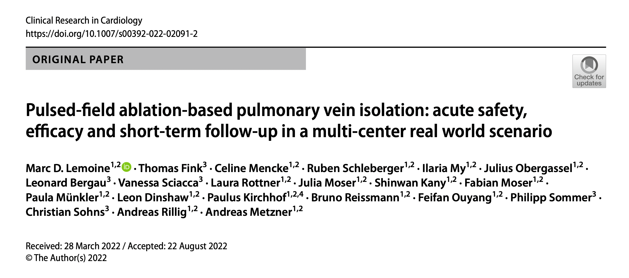

Slide 20
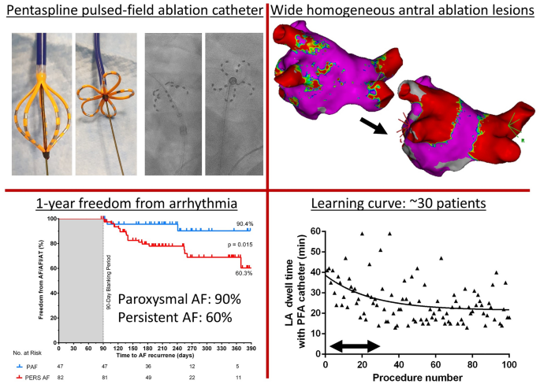
Pulsed Field Ablation

Slide 21
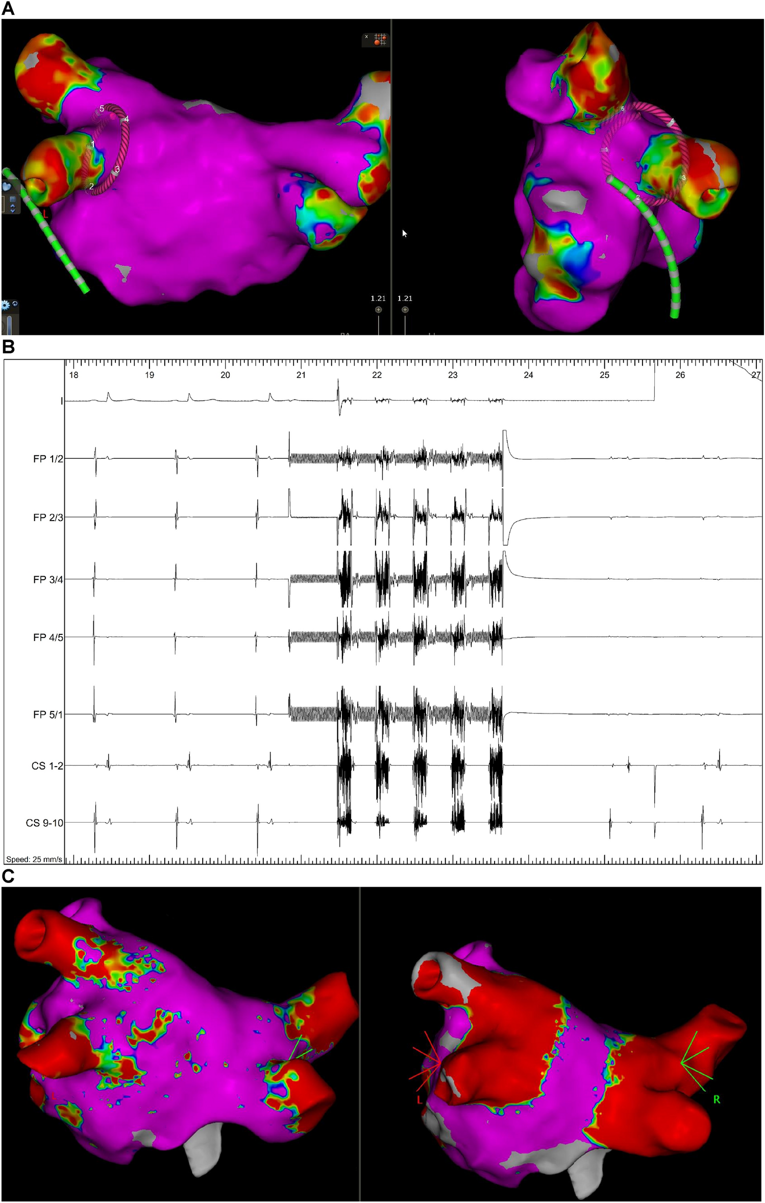
Main findings are:
PFA-based PVI achieves complete acute isolation of PV (546 of 546 PV),
acute complication rates are low (1/138 patients, 0.7%),
the PFA catheter can be visualized using commonly used mapping systems,
the system provides a short learning curve and a short PFA catheter LA dwell time,
atropine reduced the duration of post-PFA asystole and heart block,
freedom of AF/AT/AF was 90% for paroxysmal AF and 60% for persistent AF patients during 1-year follow-up.

Slide 22
Conclusion
Point by point RF ablation still the gold standard.
Clinical outcome at 80% single procedure off drugs (98% with drugs).
High efficacy, near-zero radiation workflows possible.
2. Rapid development of very fast, very powerful and potentially very safe ablation technologies.
Ultralow temperature ablation allows Cox-Maze-like lesion sets with high efficacy
PFA may be eliminate collateral damage.
3. Desired lesion sets are becoming a realistic goal.
After the decade of standardization, the next decade may be the one of therapy expansion.

Slide 23
Thank you for you attention!

